Slide 1
Research on capability of TIBCO platform

Slide 2
Background
NYP have an MOU with TIBCO to setup a centre with exhibits leveraging on TIBCO platform

Slide 3
Objective
Research and understand TIBCO platform
Identify usable components suitable for Project or curriculum
Develop demo and create usage guide to reduce learning curve to leverage on TIBCO platform

Slide 4
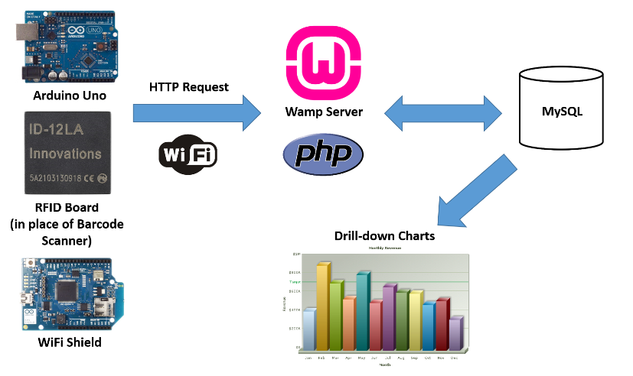
Project overview
Front/Back End Technologies used
(You can also use colour code to show who do what)

Slide 5
Overall Achievements
Mentions on overall achievements
TIBCO services capability
etc
Exploration on Spotfire
Visualisation exploration through manual upload (data.gov)
Visualisation on OH database (manual upload)
Convertor Tool
Visualisation through local database access

Slide 6
Demo
…

Slide 7
Project Weekly Achievement
Week 1 and 2
XXXX
Week 3
XXXX

Slide 8
Create Another document for these last 2 slides, show only when you’re being asked
Difficulties and how you overcome them
XXX

Slide 9
What you maybe going to do after Mid term
XXX
XXX
XXX
XXX

